Slide 1
Alertrak
Empowering Consumers to Make Informed Food Choices
Notes:
How many people here have some type of food allergies or know someone who has food allergies? What about other form of food sensitivities/intolerance like gluten or lactose?

Slide 2
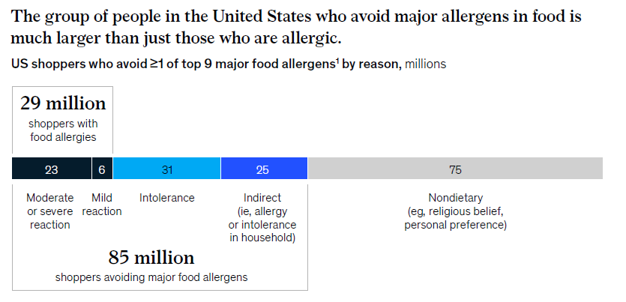
The Problem
Stats
Source: McKinsey report, Consumers-with-food-allergies-A-growing-market-remains-underserved

Slide 3
Consumer Questions:
Is this product safe? Does it have any ingredients that I am “allergic” to?
What do these ingredients mean?

Slide 4
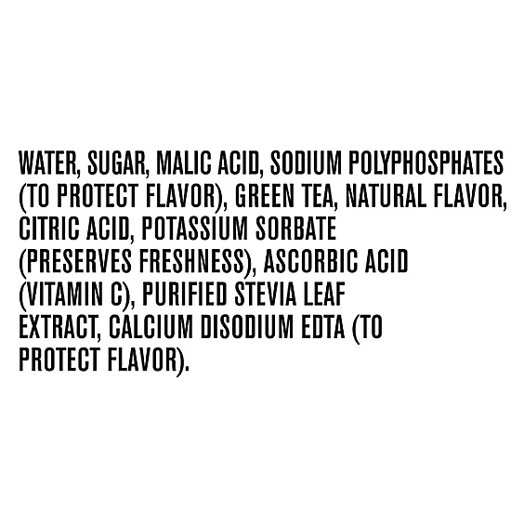

Slide 5
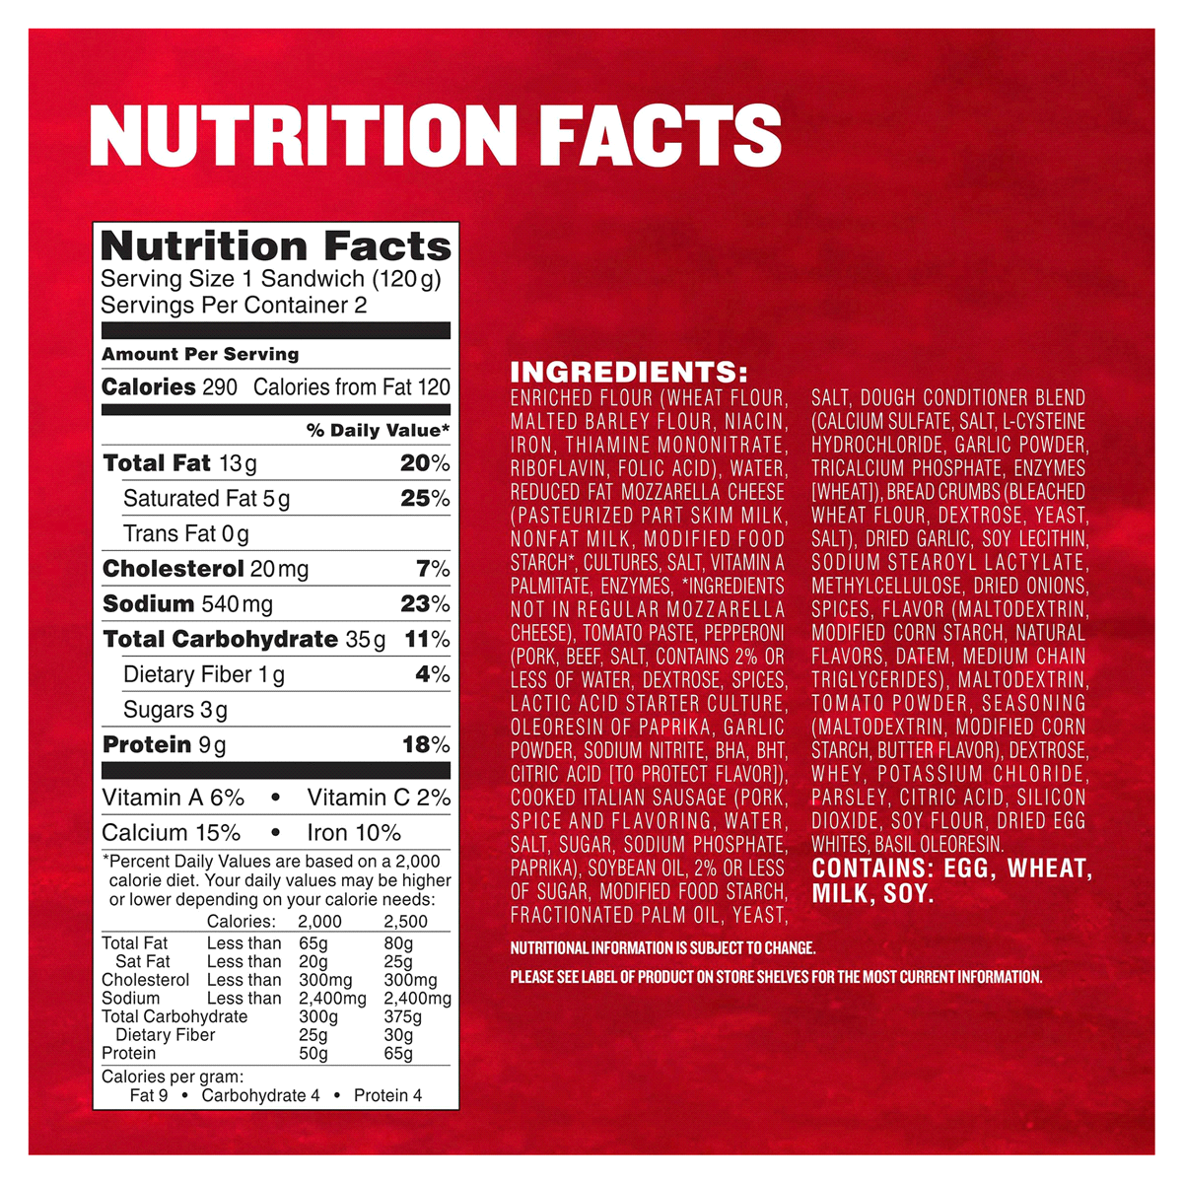

Slide 6
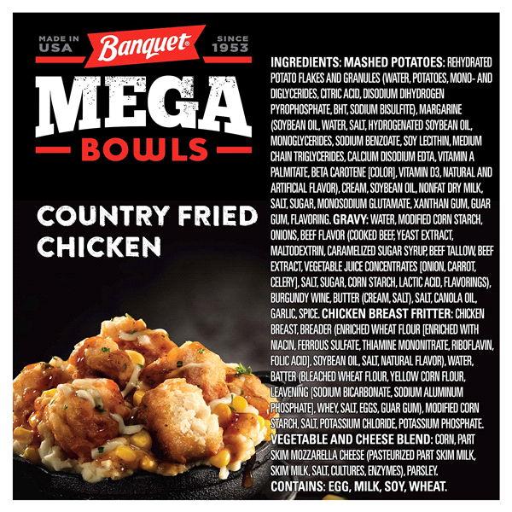

Slide 7
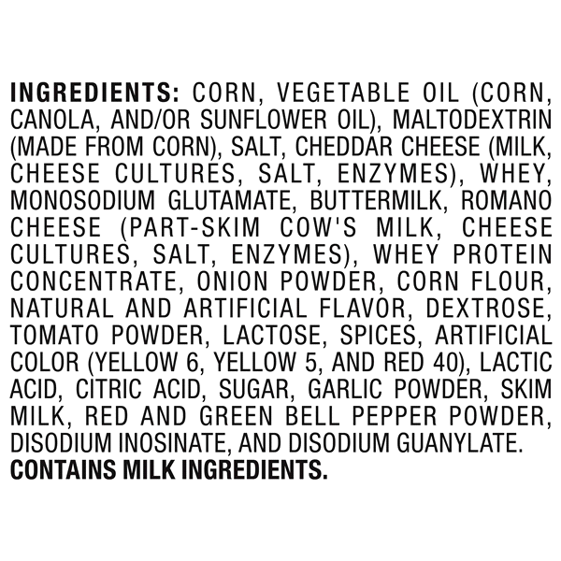

Slide 8
Consumer Questions:
Is this product safe? Does it have any ingredients that I am “allergic” to?
What do these ingredients mean?
I have this medical condition. What food should I avoid?
I have concerns about _____ (e.g. artificial coloring). What are alternatives?
What brands can I trust?
I have a lot of food allergies, what recipes can I make?
What can I eat at this restaurant?

Slide 9
Additional Stats
Spending 5% more on groceries each month than average shopper
32% willing to spend more on highest quality ingredients

Slide 10
Opportunities
Source: FARE Food Allergy Consumer Journey Study July 2020

Slide 11
Who can we help
Consumers
Find trusted food products meeting their diet needs (new and alternatives)
Find more allergy-friendly choices from their grocery stores
Provide better labeling understanding about allergens, more product information
Food manufacturers
Gain insights into new allergy-friendly product opportunities to this consumer group
Improve consumer education and engagement
A $19B potential market

Slide 12
Alertrak Contributors
Alertrak Users
Food Manufacturers
Alertrak AI Platform
Food Sensitivities
Grocery Stores
Medical Conditions
Restaurants/ Meal Delivery
Lifestyle/ Dietary
Nutritionists/ Dieticians
Religious/ Ethical
Writers/ Content Providers

Slide 13
Where we are today
Intelligent food allergy/sensitivity platform has been built and tested. Categorized:
400K+ unique food products to common food allergies/sensitivities
Built foundation to categorize more food products
40K+ brands, 6.6M+ ingredients to products
9 key allergens + 80 others, 1200 aliases
34 Medical conditions
Intelligent algorithm considering exclusions, synonyms
B2B
Vendor portal which allows them to access
APIs are developed for partners to use (food manufacturers, retailers, etc…)
Analytic framework (enable vendors to gain valuable insights into potential markets)
B2C
Web site and mobile app developed
Scan products for indication and get alternatives that fit your settings
Discover
Find me recipes that fit my needs
Blog site for interesting articles on food allergies

Slide 14
B2B Partnership Levels
B2B Partnership Levels
PARTNERSHIP | PROVISION | BENEFITS
Data share agreement enabling Alertrak to direct consumers to your brands/products | Signed agreement and API to pull data | Consumers find within your stable of brands products that accurately meet their health needs and wants
Digital marketing | Signed agreement | Targeted engagement-to-conversion
Direct product offering | Signed agreement | Consumer-initiated engagement
Integration of Alertrak’s technology: web and mobile | Signed agreement; some integration | Consumers use platform(s) just as before, while getting the added benefits of Alertrak while they shop
Analytics | Signed agreement | Access to intelligence on what consumers with specific food ingredient avoidances are looking for; insights on new product development

Slide 15
How we win
First and foremost
Consumers: Find allergy-friendly food products that meet their needs (new and alternatives)
Food manufacturers: insights into new product opportunities, improve customer engagement
Trusted and reliable source
Relentless research and enhanced algorithm
Data accuracy

Slide 16
Team
Team
Phung Le | Principal & CEO
Successful execution of high-level information and technology roles at Fortune 500 companies and internet startups
Rob Schmuecker | Solutions Architect
17 years’ experience developing and deploying technical solutions and applications.
Surojit Paul | Developer
9 years’ experience developing a wide variety of B2B and B2C web and mobile platforms; skilled in front- and back-end technologies as well as technical solutions.
Lisa Le | Researcher
Background in biochemistry and biotechnology; currently works at a biotech startup focused on consumer health care.
Linda Le | Researcher
Strategic data analyst with a strong background in statistics; expertise in creating interactive reports provides actionable insights to grocery stores and food manufacturers regarding consumer preferences.
Elisa Chemayne Agostinho | Consultancy, Content, Marketing & PR
Extensive background in consumer editorial and corporate communications, marketing and PR across for-profit and nonprofit sectors; additionally serves as consultant at-large.
Advisors: Nutritionist, Allergist

Slide 17
Ask and Use of Funds
$2M
Partnership Development
Food Manufacturers
Food Vendors
User Adoption
Technology Development
Allergy/Health Research
Data
24-Month Timeline
160,000 Active/Engaged Consumer Users

Slide 18
Let’s talk.
Contact: Phung Le, Founder & CEO
Phone: 908.546.0057
Email: phung@alertrak.com

Slide 19
Backup slides

Slide 20
Revenue Sources
B2C
Free downloadable app for iOS and Android; web site free to use
Fee for Premium services
B2B
Partnerships with food vendors and manufacturers may be established at several levels
Revenue Streams
Consumer subscription fee
Advertising on Alertrak platform.
Product offer placement.
Licensing of Alertrak technology.
Market research and data analytics.

Slide 21
Competitors
Yuka
Sifter.shop
Trashpandaapp
Shopwell
Nutritionix
Spoonacular

Slide 22
Next Steps
Business Development
Build out team to execute
B2B
Analyze new opportunities and publish findings in social media
Find grocery chain to demo
B2C
More blogs and market in social media
Product Development
B2B
Complete build of analytic platform for subscribers
Complete build of vendor portal and subscription charges
Documentation
B2C
Buy product data initially, then transfer to grocery stores supplied data per agreements
Improve Discover page and web site and app

Slide 23
Challenges
Research
Continuous improvement
Product Data
Getting accurate, complete, and up-to-date data
Algorithm
Continuous improvement
Consumers
How to get consumers to use the platform on a regular basis
Partners
Getting to the right people to discuss partnership

Slide 24
Business Development
B2C:
Marketing
Continue to generate interesting blogs and postings on social media
Send emails to users asking about usefulness
Funding
Put ads on website and app
Market GoFundMe page
B2B
Partnerships
Grocery Stores
Send messages to C-Suite in LinkedIn or Twitter
Food Manufacturer

Slide 25
Marketing channels
Social Media
Professional offices (allergists, pediatricians, etc…)
Manual/marketing staff (flyers in front of grocery stores)
Interactive kiosks in grocery stores
Locations where parents/kids go to
Kids’ museums
Day cares
Traceable code to know which channel provides which leads
Will perform marketing performance per investment dollar

Slide 26
Future Vision – Product Development Timeline
B2C
Sep 2022 – added recipes
Apr 2023 – nonfood products. Separate app
Jun 2024 – food delivery services
Jun 2026 – expand services to Europe
Jun 2021 – Alertrak initial version launch in US
Dec 2021 – more products and improved algorithm
Jan 2023 – Interactive and donate system
Dec 2023 – add restaurants (major chains)
Jun 2025 – allergies to medicines?
Jan 2026 – expand services to Canada
B2B
Jun 2023 – partnership with grocery chains (regional)
Jun 2024 – partnership with food manufacturers
Jun 2026 – expand platform to service professionals to provide services to users
Jan 2023 – B2B portal launch
Dec 2023 – partnership with restaurant chains for data sharing
Jan 2025 – partnership with at-home food sensitivity testing companies/kits

Slide 27
2019 | 2020 | 2021 | 2022 | 2023 | 2024+
Buy “safe” food products
Search/ Shop
Exceptions/ Exclusions
Nutritional filters
Non-Food related
Food delivery/ check out
Recipes: what can I make
Restaurants
Meal delivery
Foundation for growth
Allergens Research
Algorithm
Processes
Vendor Portal
Food database
Infrastructure
APIs
App to scan and alert, alternative
Expand app to search
B2B Portal and APIs

Slide 28
Future Vision
Goal: To conquer the food sensitivity space and become the trusted companion for every food sensitivity need.
Breadth:
Expand platform usage throughout the U.S. and into Canada.
Expand platform usage globally.
Depth:
Expand platform database and services to address/include:
More medical conditions
Restaurant menu items: What can I order given my allergy and health settings?
Nonfood products: haircare, skincare, beauty
Medicines
Intelligent interaction. Ask Me. Allow users to ask any question to find the right food products or recipes
Growth:
Partnerships with at-home food allergy testing companies/kits.
Marketing partnerships with allergists and related health care individuals and entities.
Enabling platform for services like meal plans for specific health needs
AI predictive non-invasive diagnosis tool

Slide 29
Taglines
"Empowering Consumers to Make Informed Food Choices“
"Eat Smarter, Live Better - Discover Allergy-Friendly Food Products with Our Platform“
"Your trusted guide to better food choices for healthier eating!“
"Discover the Smart Way to Shop for Allergy-Friendly Foods!“
"Unlock New Possibilities with Allergy-Friendly Products: Get Insights, Education, and Engagement for Your Food Manufacturing Business.“
"Unlock the Potential of Allergy-Friendly Food with Our Innovative Platform!"

Slide 30
Position statements
We believe that all consumers should have access to safe and nutritious food options that are tailored to their individual diet and allergen needs. That’s why we support the development of a platform that will help consumers find food products that meet their specific dietary needs, while also providing them with more detailed product information. This platform would enable consumers to quickly and easily identify food products that are safe for them to consume, as well as provide them with additional information about ingredients, nutritional value, and other relevant details. Furthermore, it should be designed to be accessible and user-friendly, so that anyone can take advantage of the service. By streamlining the process of finding safe and nutritious food products, we can ensure that all consumers have access to the food items they need to stay healthy.
We are committed to providing food manufacturers with better insights into allergy-friendly food product opportunities and improving consumer education and engagement. We recognize the need for allergy-friendly food products that meet the needs of the growing number of people with food allergies, while still providing a delicious and nutritious meal. Our platform will provide food manufacturers with the tools to create and market new, innovative products that are safe, affordable, and enjoyable for all. We will also strive to educate consumers on the importance of recognizing food allergies and the safety measures that must be taken when preparing and consuming food products. Through our platform, food manufacturers will be able to access an array of resources to help them better understand food allergies and the necessary steps to ensure the safety of their products. Additionally, we will work to engage consumers in the conversation surrounding food allergies and the importance of proper labeling and awareness. Our platform will be a valuable resource for food manufacturers, consumers, and the food allergy community.

Slide 31
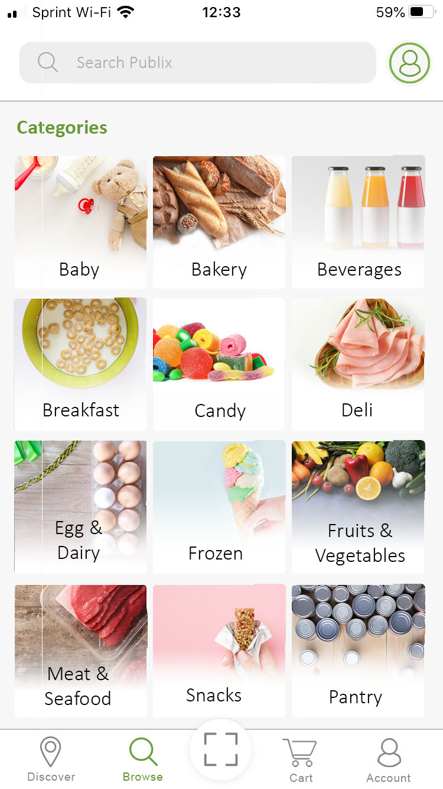
Set up individualized allergen settings for everyone in your household by ticking off the appropriate boxes.
Select a category, like Dairy & Eggs, and Alertrak will populate with all your options so you can browse through.

Slide 32
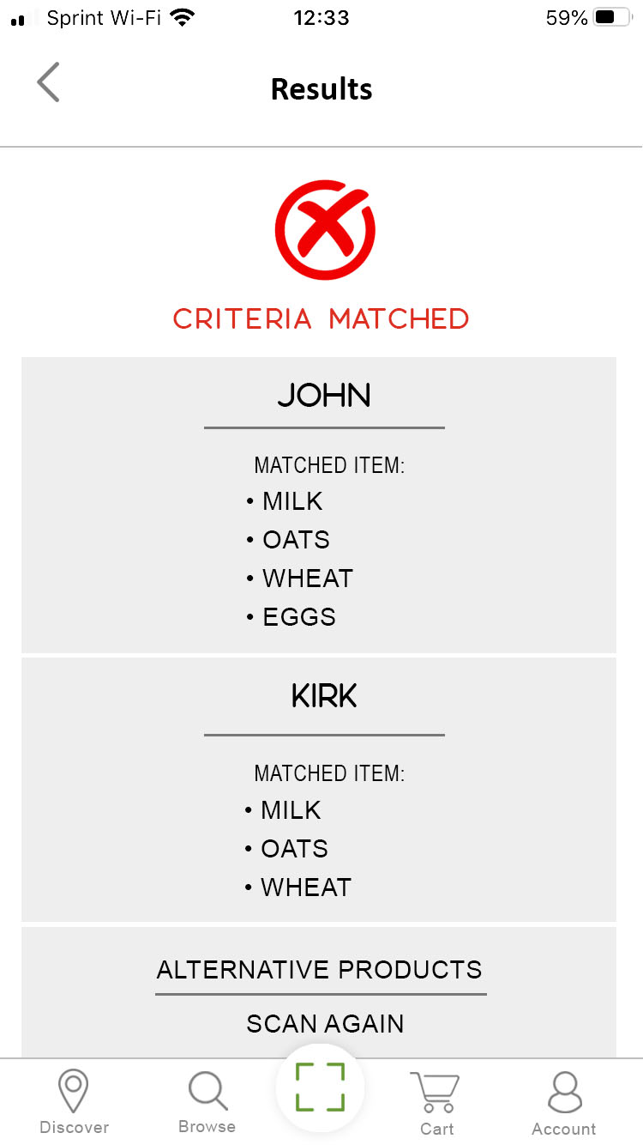
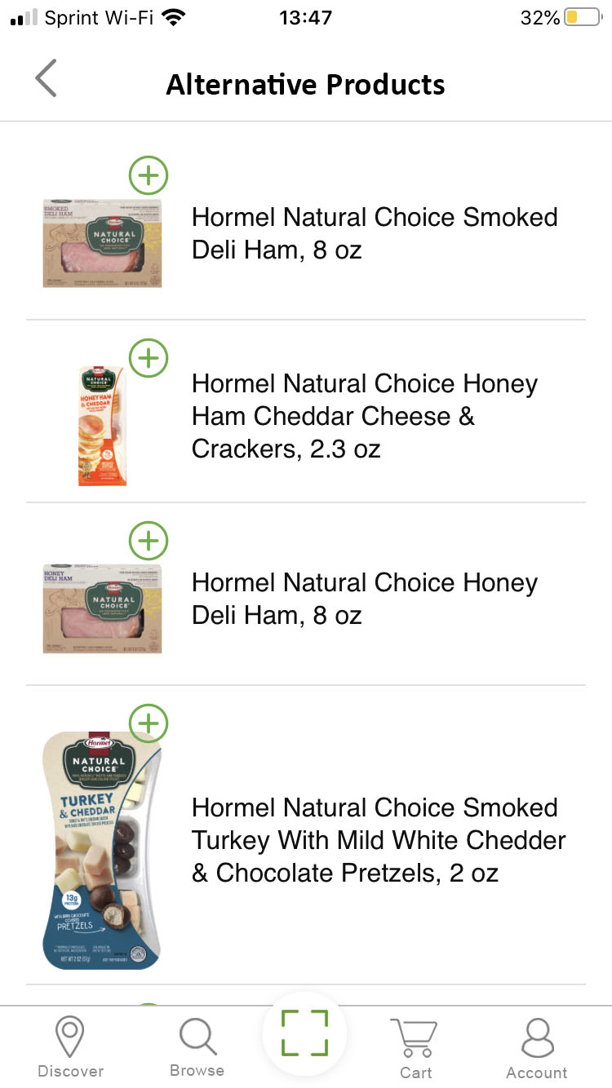
You can also scan product labels in store to immediately know whether or not they’re a match for your allergen settings.
If you scan a product that doesn’t match your allergy settings, you’ll be provided with a list of similar alternative products to consider.

Slide 33
Challenges
“Current methods of diagnostic testing for food allergy are often inconclusive, and in the case of food challenges sometimes stressful and scary.” – Foodallergy.org
Skin prick test
Blood test
Oral Food Challenge
No cure yet for food allergies.
Food intolerances or other sensitivities – avoidance

Slide 34
Journey of affected person
Cure?
NO
Diagnosis
Treatment?
YES for serious and mild cases
What am I allergic to
Prevention
Alertrak was created to address part of Prevention – alert

Slide 35
The Solution
Alertrak, a comprehensive, accurate and speedy platform that does away with the guesswork and labor-intensive nature of allergen-avoidant food shopping.
Extensive database covering all food product and allergen categories.
Heuristic algorithm that instantly recognizes a product, identifies known allergens therein, and analyzes that information in context to identify what products must be avoided while suggesting viable alternatives.
Customizable user platform.

