Slide 4
Notes:
Two things both Voters and Candidates need more of………MONEY and TIME.

Slide 5
Notes:
Saves MONEY and TIME!

Slide 6
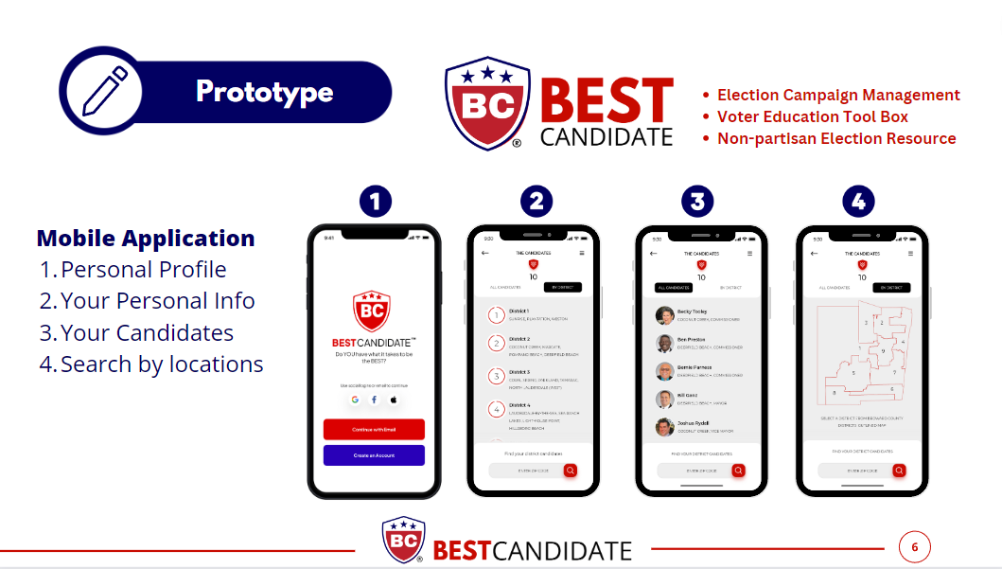

Slide 12
Notes:
Somebody tells you you are playing the Kansas City Chiefs next week. You go and recruit the best top experts you can find. And that’s what we’ve done.

Slide 13
Notes:
We invite you to join us on the Beta Test.

