Slide 1
Guiltless
“Order Smarter, Eat Healthier, and Guilt-less!”
______________________________________
AI-Powered App Making Healthy
On-Demand Ordering Easy
Private & Confidential | lucie@guiltlesstogo.com

Slide 2
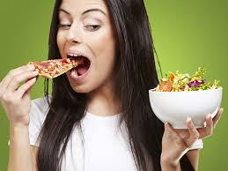
Eating Healthy is Hard…
Private & Confidential | lucie@guiltlesstogo.com

Slide 3
Healthy On-Demand Ordering Made Easy…
AI Will Tell You What to Eat!
Private & Confidential | lucie@guiltlesstogo.com

Slide 4
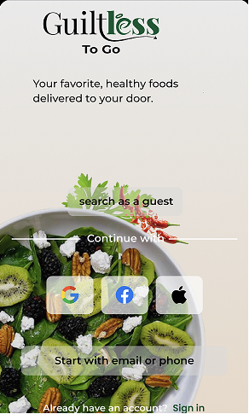
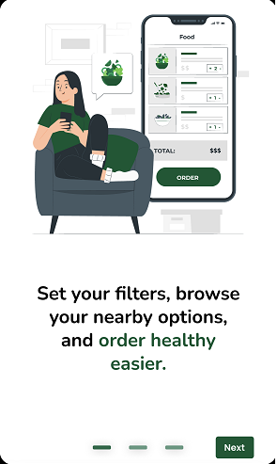
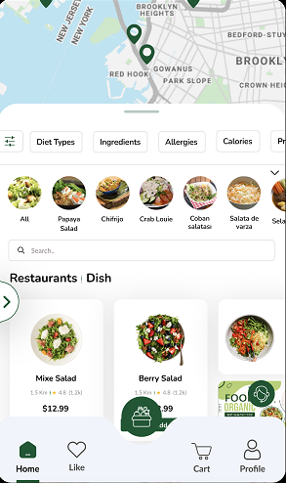
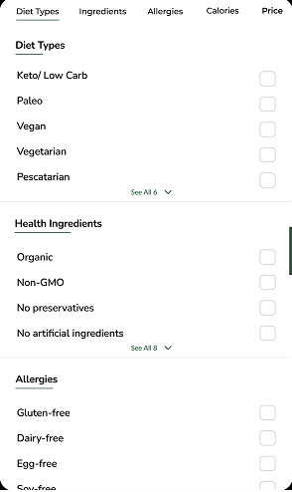
Minimum Viable Product (MVP) Demo
Tap grocery basket to toggle to grocery side of app
Product Demo | Private & Confidential | lucie@guiltlesstogo.com

Slide 5
On-Demand Delivery Market is HUGE!
So is a slice of the pie…
TAM = $56B - $96B
Total US Food Delivery Market (2021)
“Total Addressable Market”
SAM = $27B
Total US Platform-to-Consumer Delivery
“Serviceable Available Market”
SOM = $9B - $14B
35% - 52% Health-Conscious Americans
“Serviceable Obtainable Market”
Private & Confidential | lucie@guiltlesstogo.com

Slide 6
How We’re Different - Bridging the Gap…
Healthy
On-Demand
Delivery
Healthy
Subscription Delivery
On-Demand Delivery
Private & Confidential | lucie@guiltlesstogo.com

Slide 7
Competitive Analysis…
Competitors | Guiltless ToGo | Door Dash | Uber Eats | Grub Hub | Instacart
Pricing | $2 Service fee + 3% processing fee + driver partner fees | About 20% of total | Ranges from 30-40% of total | Can go as high as 30% of total | About 25% of total
Filters | Filters for Specific Healthy or Dietary Preferences | Filters for Mainstream Limited healthy | Filters for Mainstream Limited Healthy | Filters for Mainstream Limited Healthy | Filters for Grocery Aisles Search Bar only
Feature 1 | Filtered Only Appears Distractions Disappear | ❌ | ❌ | ❌ | ❌
Feature 2 | Finds Lowest Prices | ❌ | ❌ | ❌ | ❌
Feature 3 | Modifications Done-for-Users | ❌ | ❌ | ❌ | ❌
Feature 4 | Calculates Estimated Calories & Macros | ❌ | ❌ | ❌ | ❌
Feature 5 | 1-Click QR Code Checkout for Meal plans, Recipes, Groceries | ❌ | ❌ | ❌ | ❌
Feature 6 | GPS Tracking of Delivery | ✔️ | ✔️ | ✔️ | ✔️
Competitive Analysis | Private & Confidential | lucie@guiltlesstogo.com

Slide 8
Business Model & Revenue…
DTC: $2 Service Fee Per Order
B2B: CPG Ads - Revenue Per Click- White Labeling App
Low Operation Costs + Patentable Technology
Technology Patentable Guiltless AI
Logistics
Delivery partner infrastructure nationwide
Scalability
1M + retailers & restaurants nationwide
Private & Confidential | lucie@guiltlesstogo.com

Slide 9
Guiltless Rx - Prescribed Nutrition- Food as Medicine
Private & Confidential | lucie@guiltlesstogo.com

Slide 10
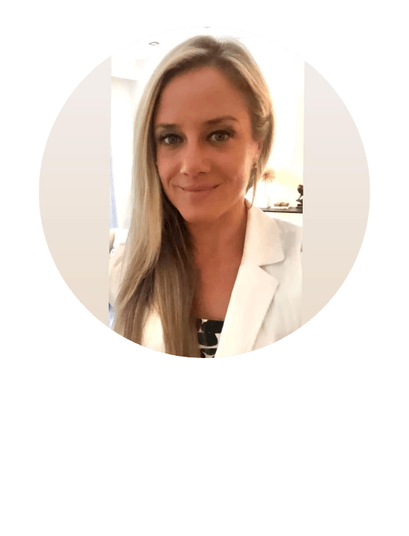
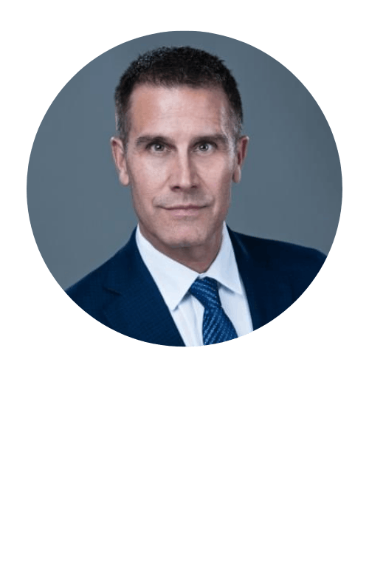
Management Team Born to Build It…
Lucie Allaire
Dr. Edwin Hernandez
Bruno Allaire
(CEO/ Founder)
(CTO/ Co-Founder)
(Part-Time CFO/Advisor)
Marketing Health Specialist
10 Years Exp - Weight loss/Health
Dream Idea
PHD Computer Engineer
20 Years Exp - 13 Issued Patents
Genius Coder –Patent & AI Expert
Harvard MBA Financial
28 Years Exp. – Entrepreneur
Business Consultant
Private & Confidential | lucie@guiltlesstogo.com

Slide 11
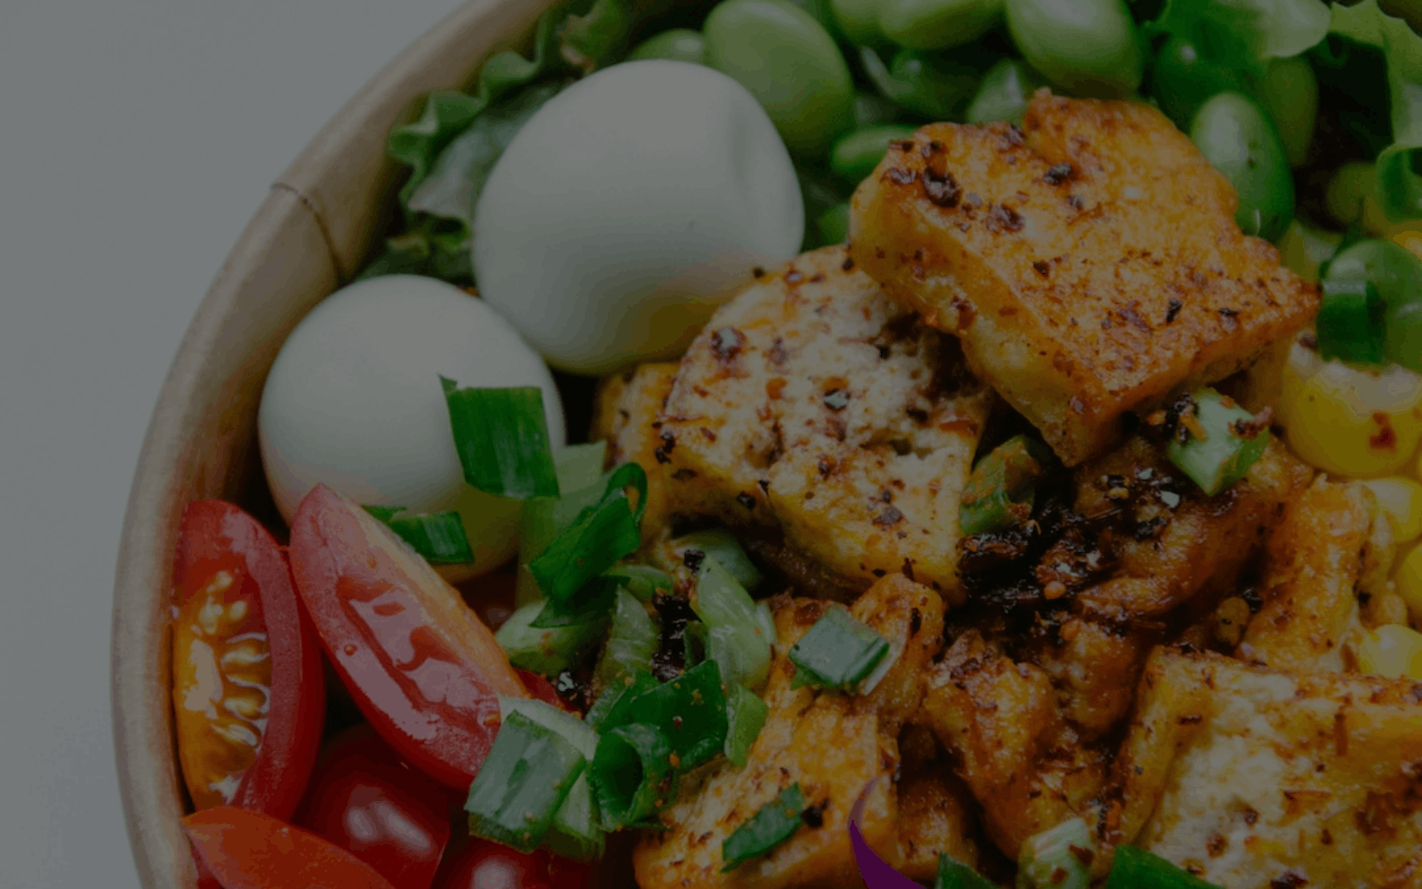
Traction: Progress to Date…
Filed Florida LLC - Trademarks filed
Bank Account and Processing Account Set Up
Key Supplier Partnerships Executed – 1M + Restaurants/Retailers
About to launch MVP for Beta Testing
Next Milestone is Go-To-Market
Traction | Private & Confidential | lucie@guiltlesstogo.com

Slide 12
.
Want to help us make Guiltless To Go become first in
consumers’ minds for healthy on-demand ordering?
If so, we’d love to talk to you…Any Questions?
Lucie Allaire
Founder/CEO
Mobile: (954) 600-3218
Email: lucie@guiltlesstogo.com

Slide 13
Appendix (extra slides available on request):
Slide 13 – Competitive Analysis
Slide 14 – Why Now II: Purchasing % Made by Food Claims
Slide 15 – How It Works
Slide 16-19: IP Patentable Technology & Features
Slide 20 – Customer Personas
Slide 21 – Go-To-Market Strategy
Slide 22 – Future Growth Plans
Appendix | Private & Confidential | lucie@guiltlesstogo.com

Slide 14
AI-Specified Modifications Done for YOU…
MORE
OPTIONS
…No Bun / No Starch
Lettuce Wrap
Double Veggies
=
Private & Confidential | lucie@guiltlesstogo.com

Slide 15
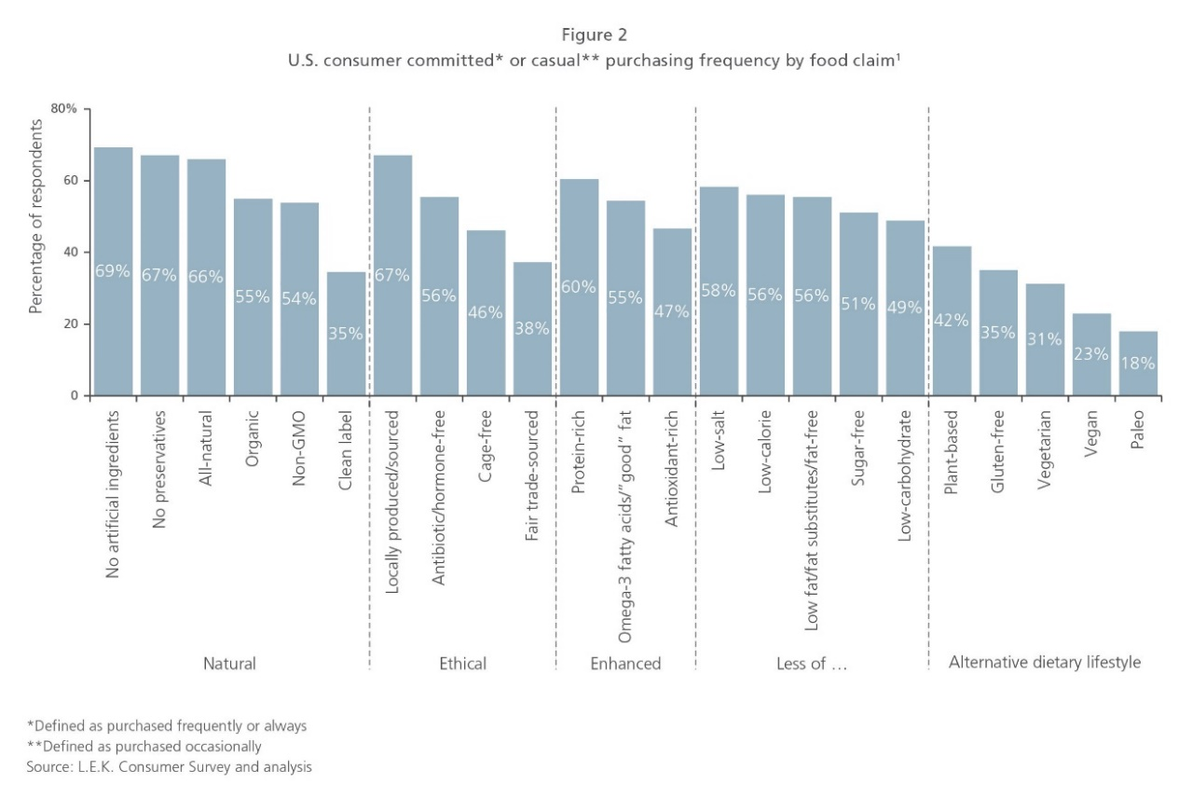
Purchasing Decisions Made by Food Claims...
Why Now # 2 | Private & Confidential | lucie@guiltlesstogo.com

Slide 16
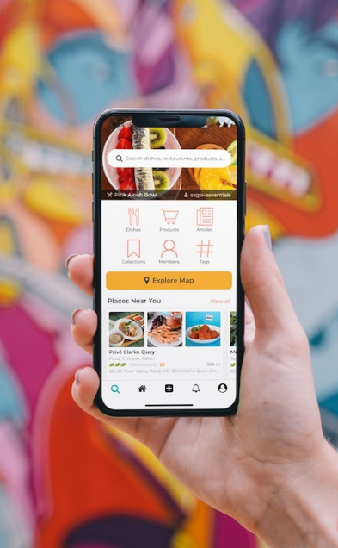
How It Works…
Users set filters to search within delivery zip code
See filtered options only
Finds lowest prices
Select pick up or delivery & choose best courier
AI-generated suggestions
Past order history saved
How It Works | Private & Confidential | lucie@guiltlesstogo.com

Slide 17
Underlying Magic IP Patentable Technology
Guiltless AI
Trained Model
AI Chat Bot
AI-Generated User Recommendations
1-Click QR Code Checkouts
IP Technology | Private & Confidential | lucie@guiltlesstogo.com

Slide 18
AI-Generated Modifications Done for YOU…
MORE
OPTIONS
i.e. Keto/Low Carb
….No Bun / No Starch
=
Lettuce Wrap
Double Veggies
Technology Feature # 1 | Private & Confidential | lucie@guiltlesstogo.com

Slide 19
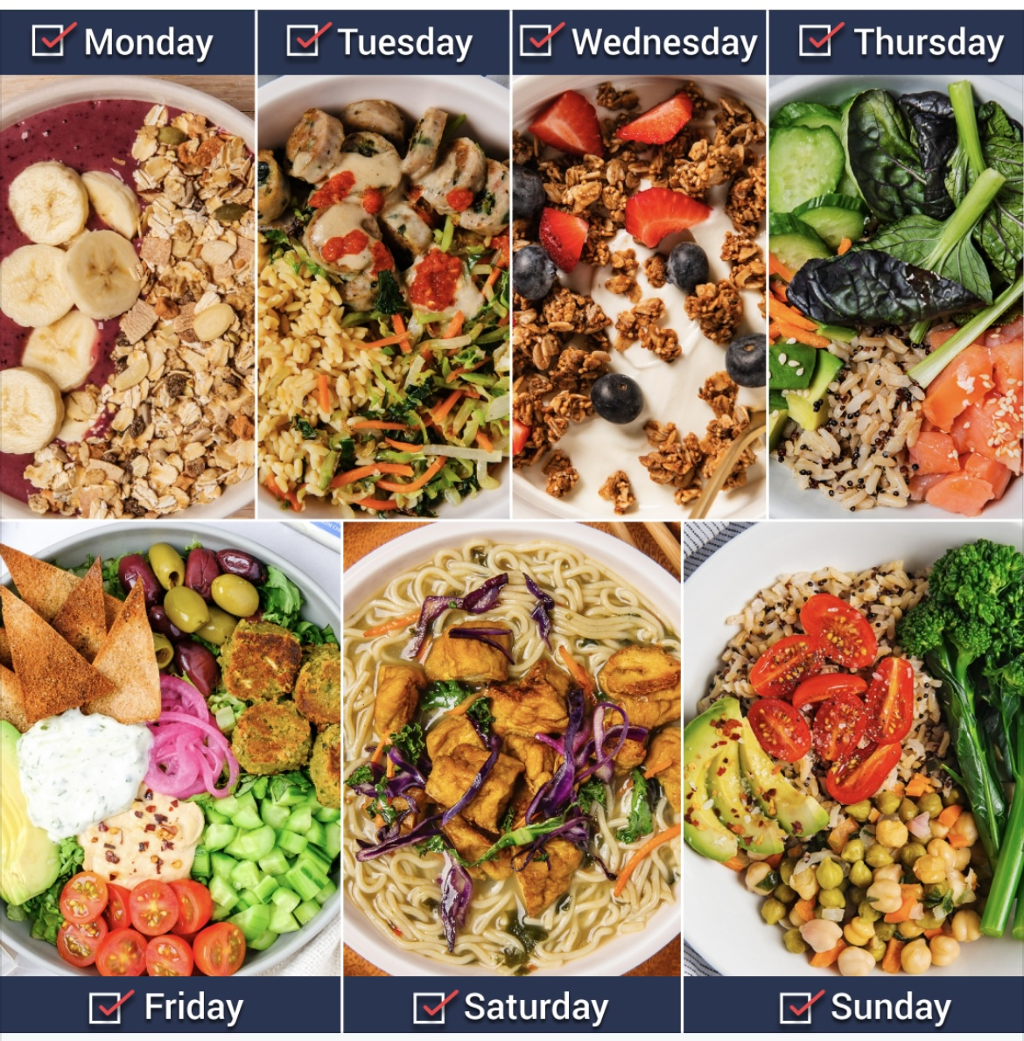
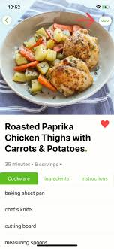
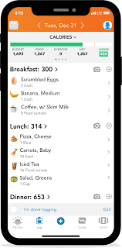
AI-Generated User Recommendations…
1-Click QR Code Checkouts
Recipes &
Grocery Lists
(Order Nearby Groceries)
Guiltless
Macro Calorie
Counter
On-Demand Meals/Meal Plans
(Order Nearby Restaurants)
Sync
By Diet Type & Calories
Technology Feature # 2 | Private & Confidential | lucie@guiltlesstogo.com

Slide 20
Guiltless Health Rx: AI-Prescribed Nutrition…
Technology Feature # 3 | Private & Confidential | lucie@guiltlesstogo.com

Slide 21
Who Will Use It…
Customer Persona
People who don't want to go out or cook and want convenience for ordering healthy easier
Health-conscious: Diet-type, ingredient, allergy, calorie conscious people & fitness enthusiast
B2B services, healthcare, & partnerships focused on healthy niche
Customer Personas | Private & Confidential | lucie@guiltlesstogo.com

Slide 22
Go-To-Market Strategy…
Digital marketing: SEO & Social Media
Paid/Organic Ads
FB, IG, & TikTok
Influencer Strategy: Health, wellness,
weight-loss, fitness, nutrition space
Partnership Strategy: Gyms, Trainers, Coaches, Dietitians, Corporate, Healthcare, Doctors, etc.
Go-To-Market | Private & Confidential | lucie@guiltlesstogo.com

Slide 23
Future Growth Plans…
B2C Product #1:
B2B2C Product #2:
B2B Product #3:
"Guiltless To Go"
"Guiltless Health Rx"
"Guiltless Merchants"
Ordering App
Grocery retailers & restaurants by diet types, ingredients, allergies, & calories
Healthcare
‘Food as Medicine’ platform for prescribed nutrition for doctors, Medicare, insurance, etc.
Merchant services
Ads for CPG brands & restaurants, AI Plugins, NFT food verse, White labeling, SaaS etc.
Future Growth Plans | Private & Confidential | lucie@guiltlesstogo.com

Slide 24
Underlying Magic IP - Patentable Technology
Guilt-Less AI
Filter Converter
AI Chat Bot
Generated User Recommendations
1-Click QR Code Checkouts
Private & Confidential | lucie@guiltlesstogo.com

Slide 25
AI-Generated User Recommendations…
1-Click QR Code Checkouts
Recipes & Grocery Lists
Guiltless
Macro Calorie
Counter
On-Demand Meals
(Order Nearby Restaurants & Retailers)
Sync
By Diet Type & Calories
Technology Feature # 3 | Private & Confidential | lucie@guiltlesstogo.com

Slide 26
Go To Market Plan Strategy…
Digital
Marketing
Influencer
Strategy
Partnership
Strategy
Private & Confidential | lucie@guiltlessai.com

