Slide 1



Notes:
Welcome to the EmotionTrac business opportunity.

Slide 2

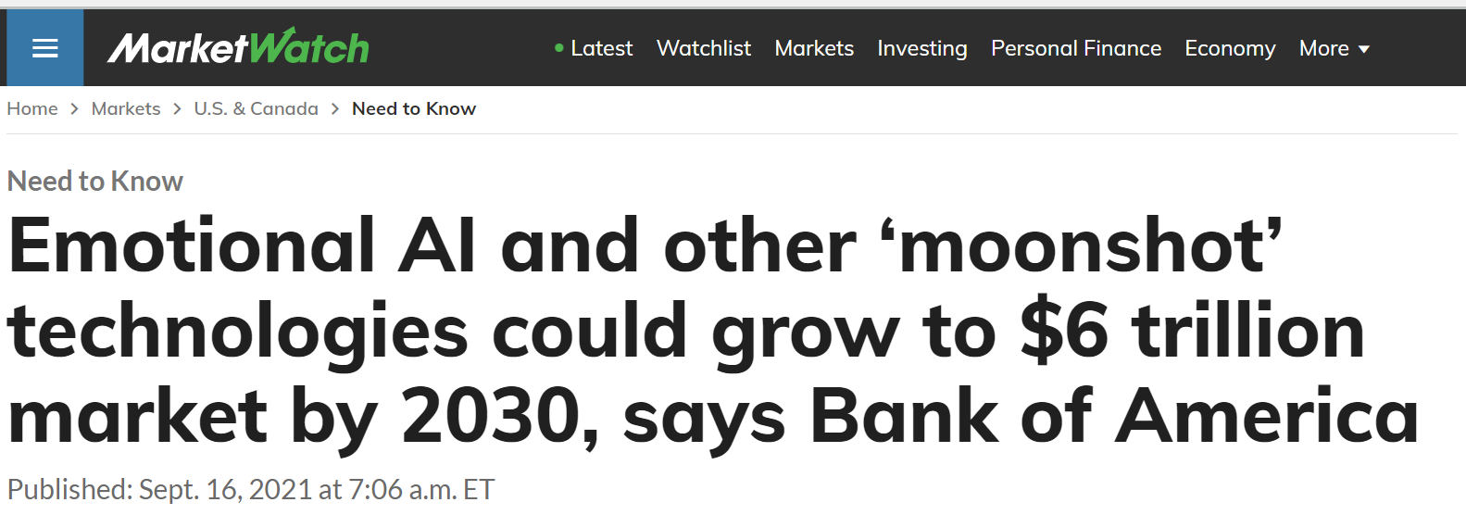
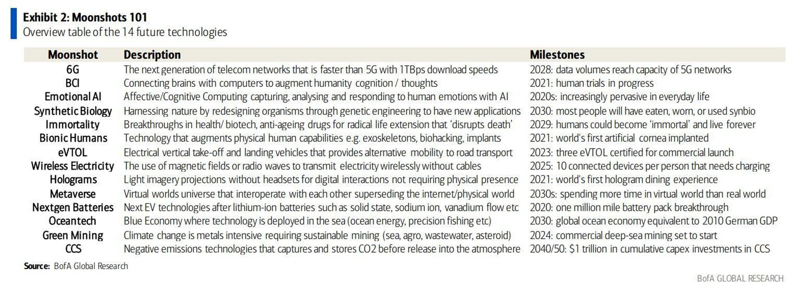
Notes:
EmotionTrac is part of the Emotion AI industry, which Bank of America recently report to be one of 14 Moonshot technologies that are together expected to achieve $6 Trillion in revenue by 2030.

Slide 3
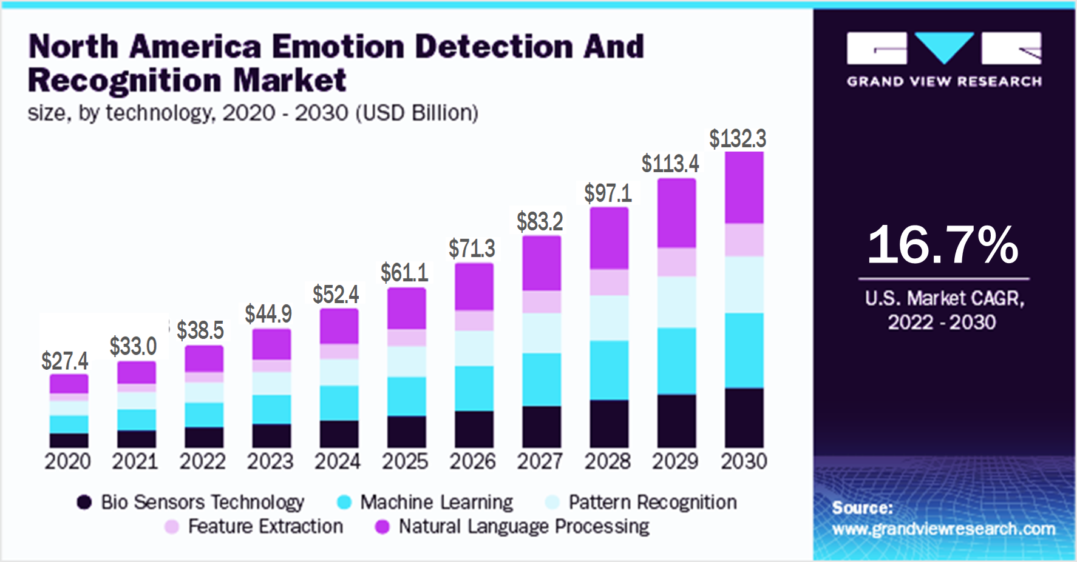
Emotion AI Market
$132 Billion in 2030
Notes:
EmotionTrac is part of the Emotion Detection Industry that is $45 Billion today and will grow to $132 Billion by 2030.
The outlook for rapid growth is very bright, but there is an industry problem getting to that growth.

Slide 4


Emotion AI
Notes:
Consent is difficult to obtain,
and the lack of consent is causing a flashpoint

Slide 5




Notes:
In the current environment where just asking for consent can create customer backlash, large brands are rethinking emotion detection
Zoom, Intel, Spotify and Google have recently been drawn into this AI controversy.

Slide 6
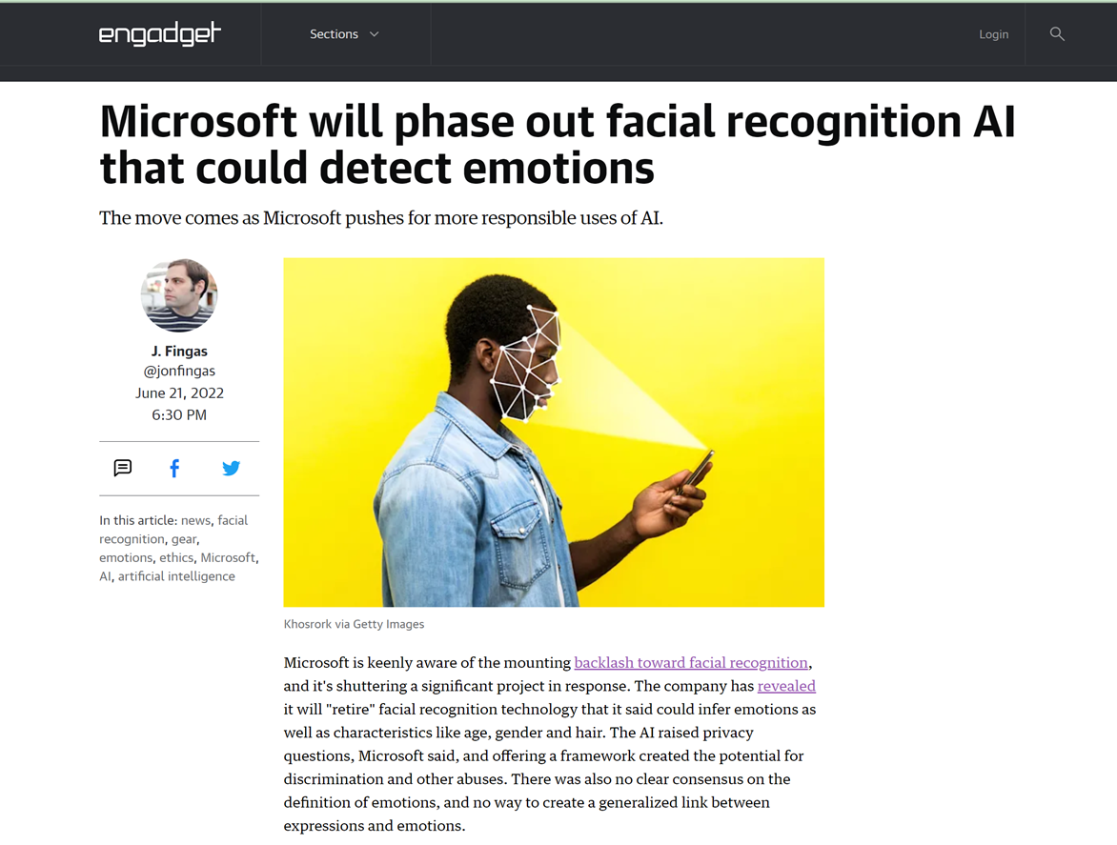

Notes:
Even Microsoft has announced they are phasing out emotion detection.
This artificial intelligence is generating enormous cultural risks.

Slide 7


Access to 149 million panelists
Notes:
EmotionTrac presents a comprehensive solution, while providing access to the world’s largest consenting audience.
It is a fast, efficient, responsible gateway to emotion AI.

Slide 8
Immediate Markets
Commercials
Film
Television
Market Research
Retail Media Networks
Legal / Mock Jury
Campaigns / Elections
Notes:
The EmotionTrac technology solution is currently being sold into 7 immediate markets totaling over $1 Trillion dollars.
Our disruptive digital solution saves all of them time and money
and empowers them with high value insights

Slide 9
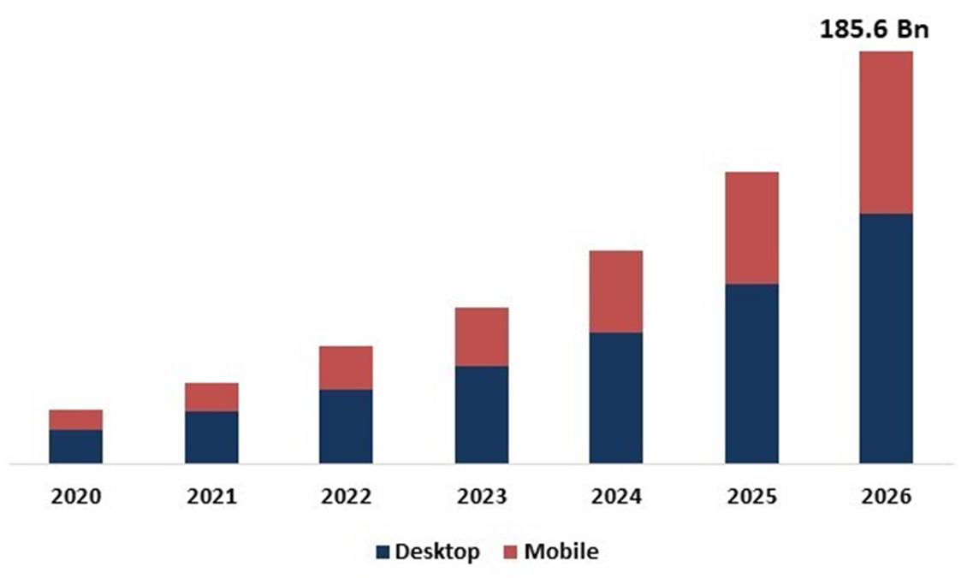

Digital Video Advertising
$186 Billion by 2026
Notes:
Digital video advertising is expected to reach $186 billion by 2026.

Slide 10
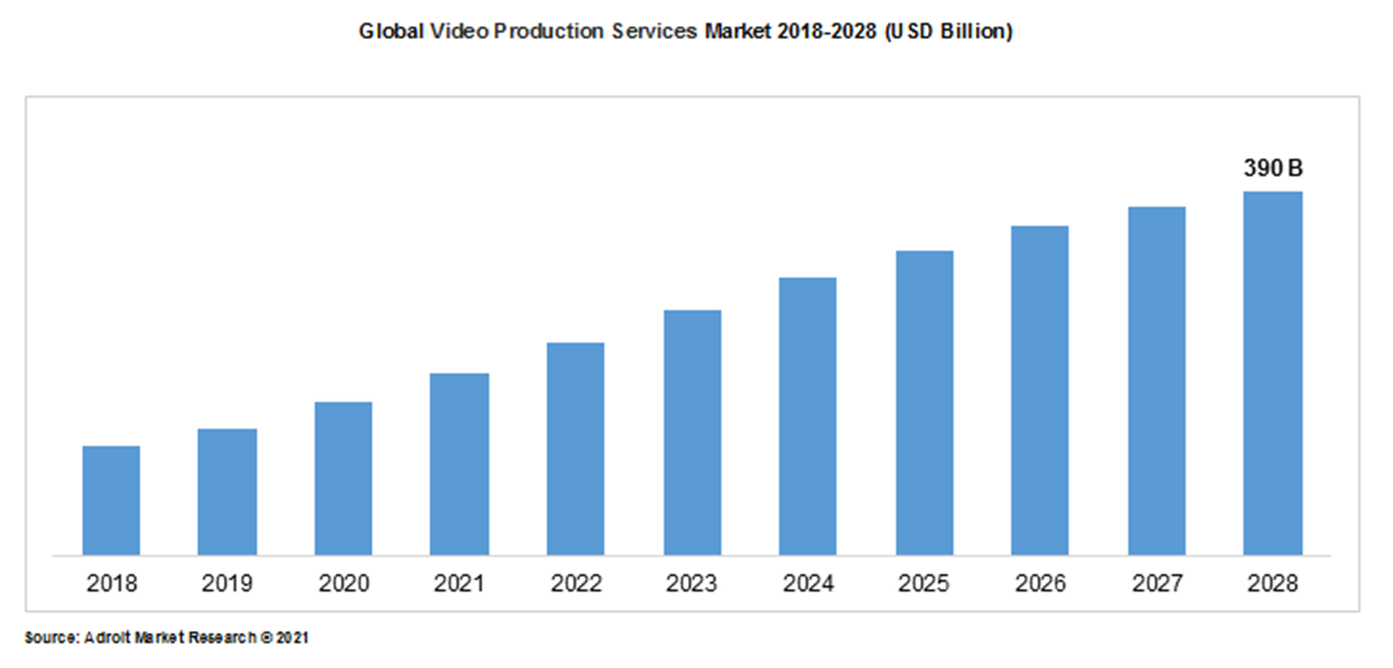
Global Video Production Services Market
$390 Billion in 2028
Notes:
The global video production services market is expected to reach $390 billion by 2028.

Slide 11
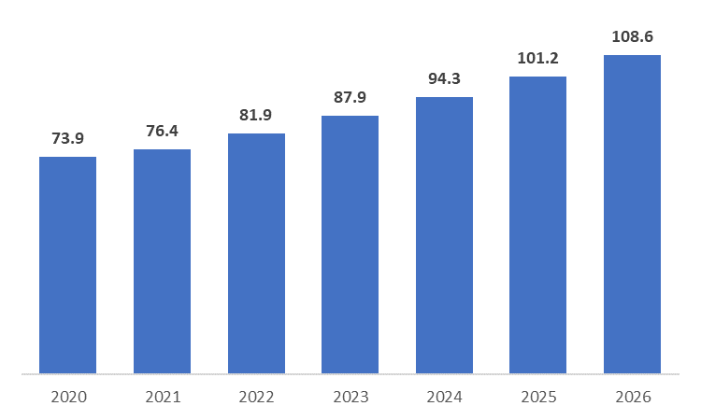
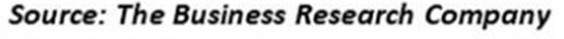
Market Research
$108 Billion in 2026
Global Market Research Service Market, Forecast Market Size,
2020-2026
Notes:
The market research industry is estimated to be at $82 billion right now and growing.

Slide 12
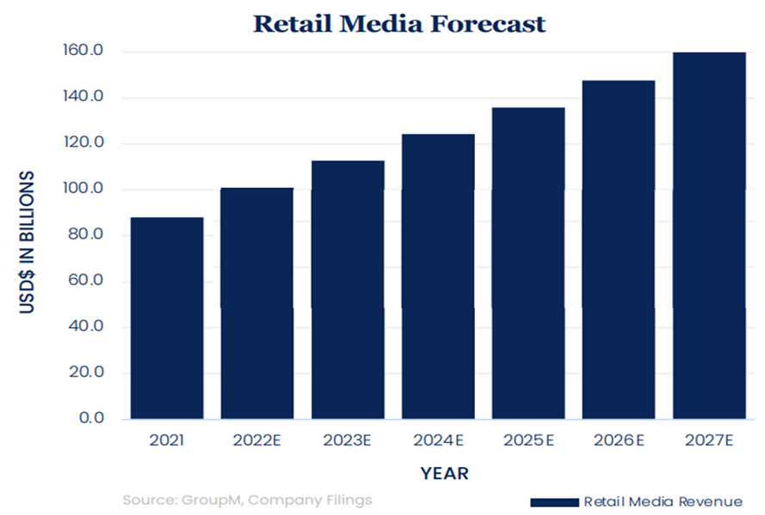
Retail Media Networks
Exceed $160 Billion in 2027
Notes:
Global retail media networks reached $101 billion in 2022 and is expected to exceed $160 billion by 2027.

Slide 13

Legal AI Software Market 31% CAGR
100,400,000 Trial cases filed per year
27% Litigation related
$70 Billion Legal Market For Emotional AI
No competitors
Notes:
The legal AI software market as a whole is growing 31% compounded annually.
There are over 100 million trial cases filed per year in the U.S.
27% of those are litigation cases
and that equates into a $70 billion addressable market for EmotionTrac’s mock jury insights
with no competition in sight.

Slide 14
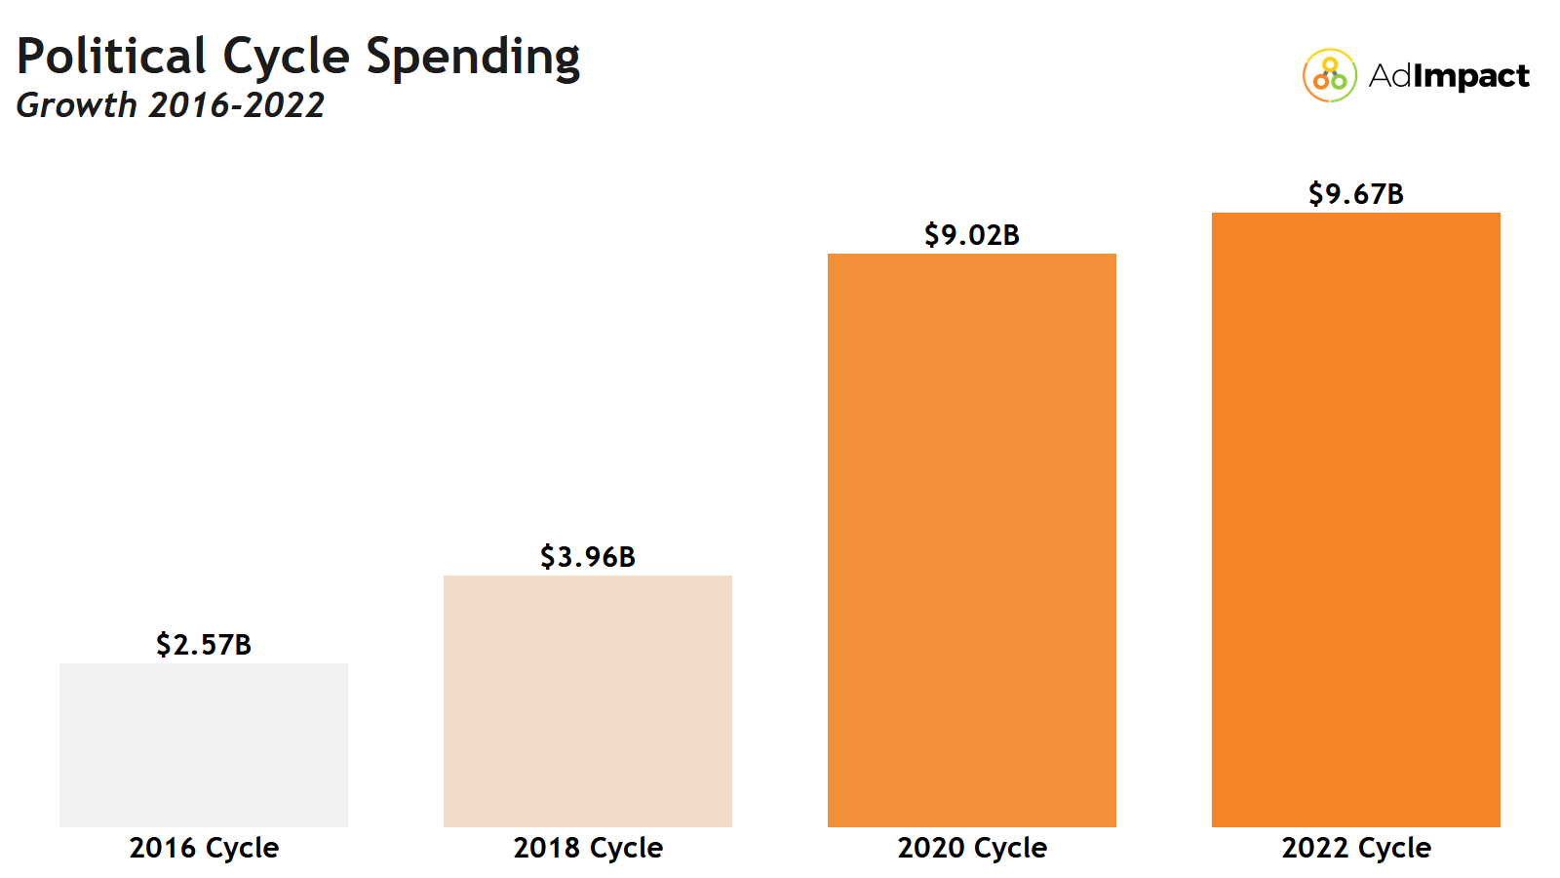
Campaign & Elections Spending
$9.6 Billion in 2022
Notes:
Between positioning and advertising the U.S. campaign and elections market in 2022 was $9.6 billion
and is expected to reach upwards of $13 billion during the next election cycle.

Slide 15
Traction
Notes:
EmotionTrac is well beyond proof-of-concept stage.
We are now accelerating revenue and building our customer base.

Slide 16
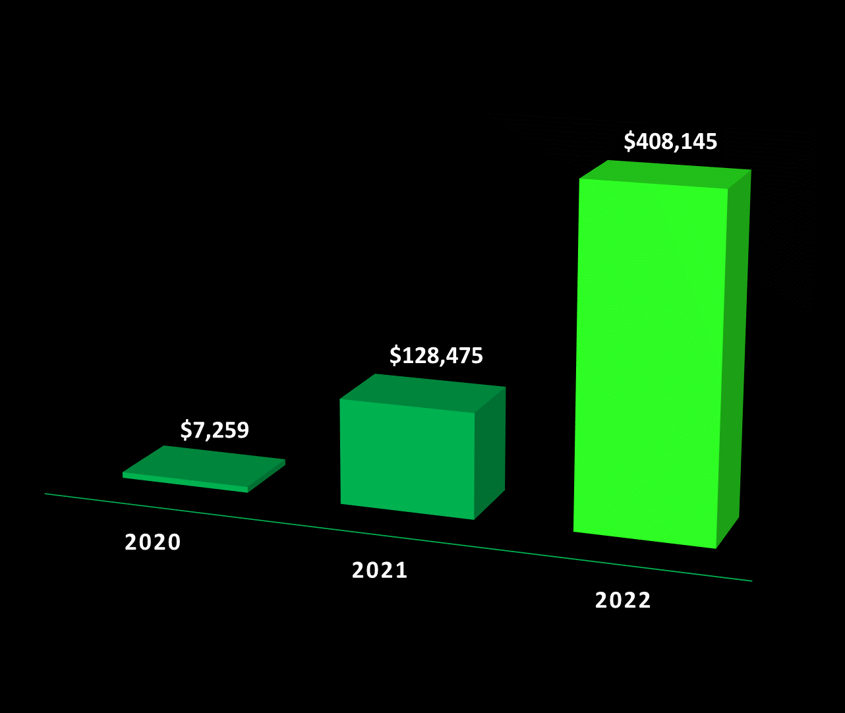
Annual Revenue
Notes:
Our revenue continues to grow exponentially quarter-over-quarter, year-over-year.

Slide 17
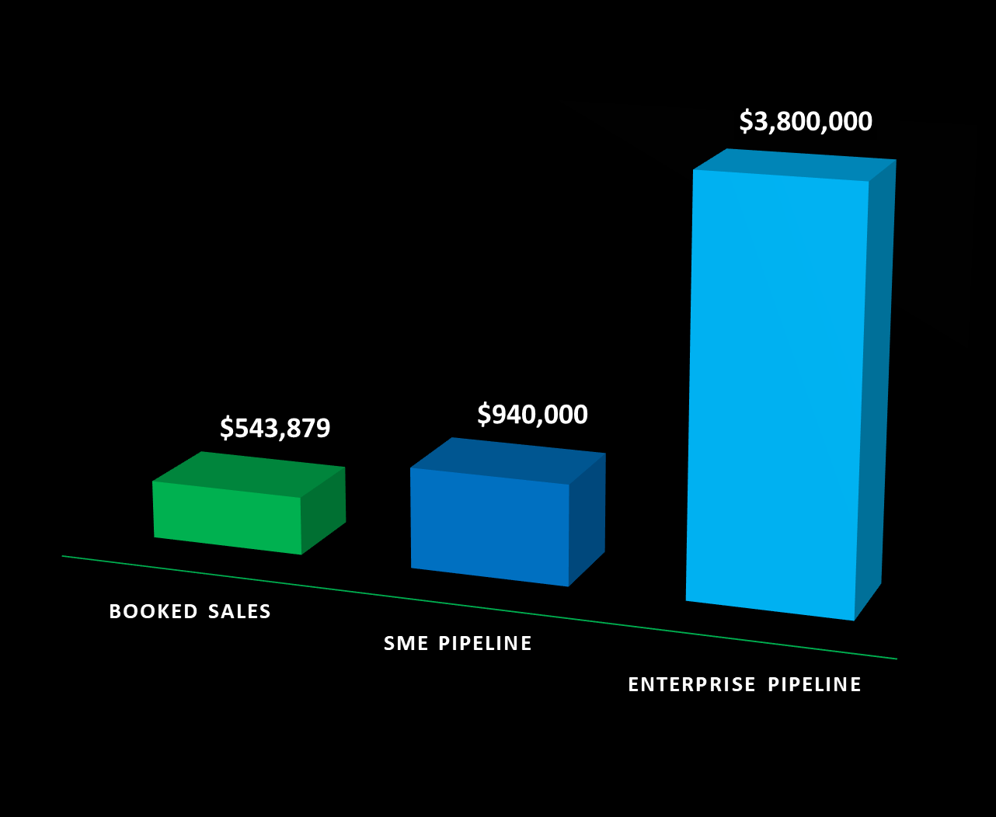
Building Opportunities
Notes:
We are constantly opening new business opportunities and are working to close those deals.

Slide 18





Clients Served 100+
Customer Value $4,800
Largest Single Order $75,000
Notes:
We already have initiated relationships with over 100 customers that have used our software.
The customer base is beginning to accelerate, and the order sizes are rising.
Customers are coming back with orders more frequently and we have numerous testimonials.

Slide 19




Creative Media
Notes:
Regularly feedback across multiple industries indicates that the results from our services are “impressive”.

Slide 20

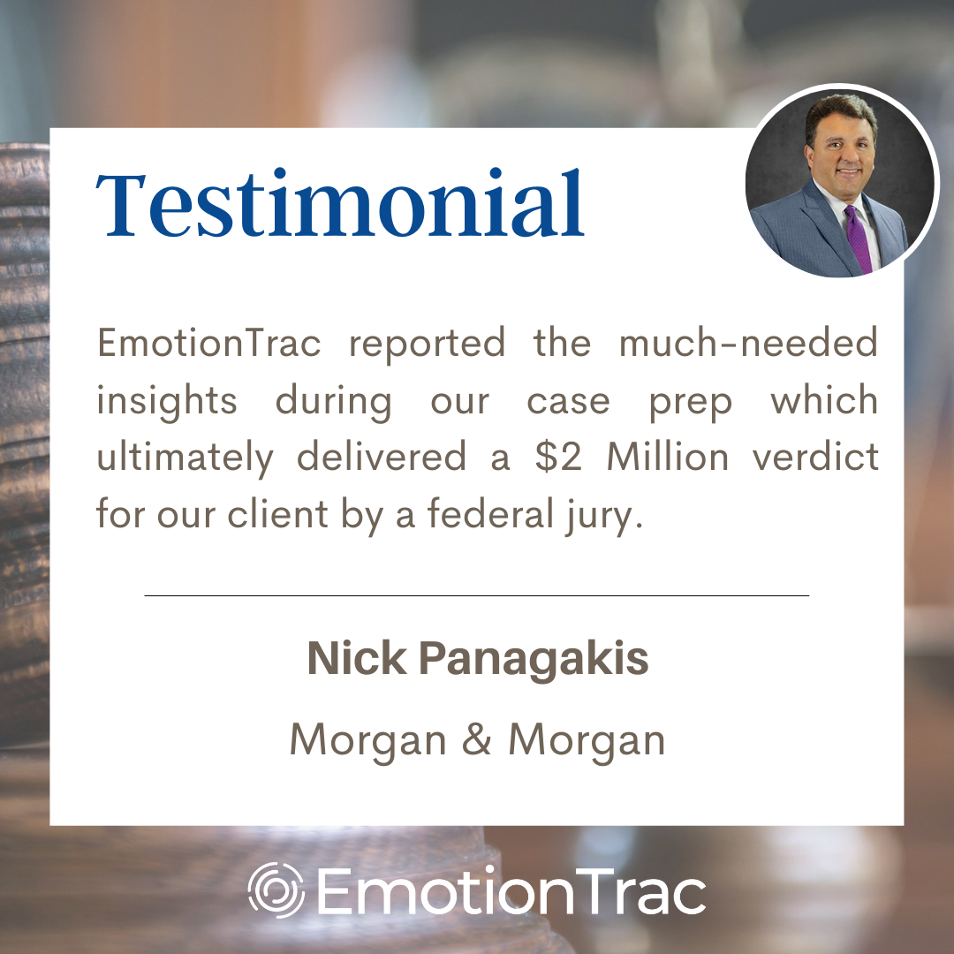



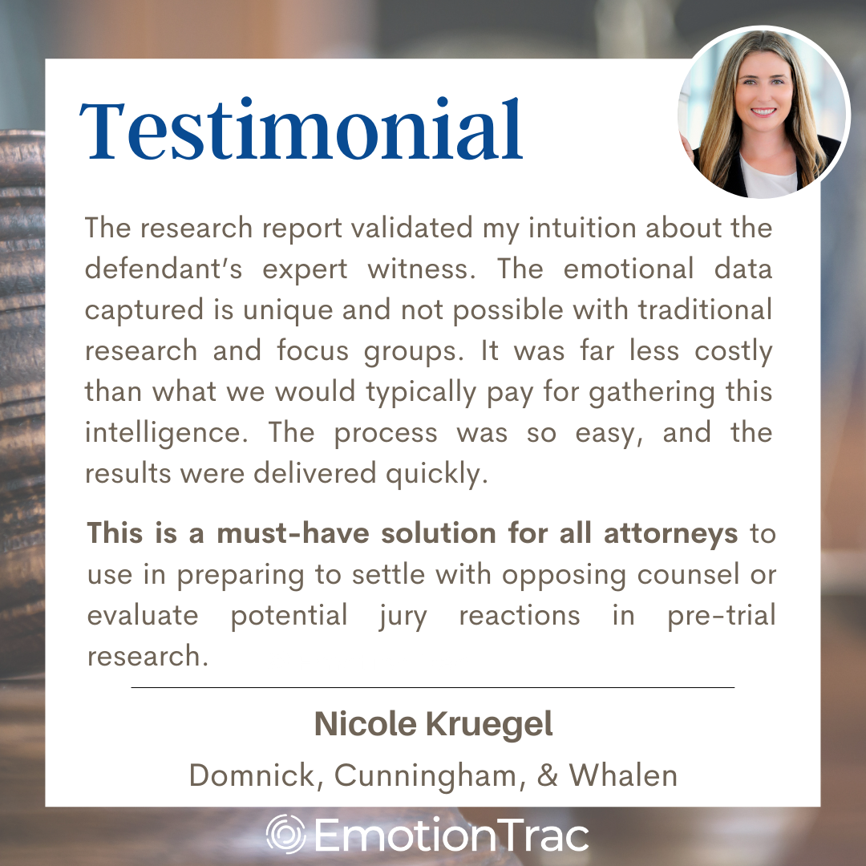
Legal
Notes:
Regularly feedback across multiple industries indicates that the results from our services are “impressive”.

Slide 21




National Awards
Best use of Artifical Intelligence to Optimize Creative
American Bar Association
Top 5
Legal Tech 2022
Notes:
EmotionTrac’s innovative technology has received nationally awards in both the creative and legal industries.

Slide 22
Intellectual Property
The technology
Measures slight changes in facial expressions while video is watched.
Determines emotional reactions and engagements second by second.
Utilizes data science to interpret reporting.
US PAT# 10,609,450
Method for hands and speech-free control of media presentations
US PAT# 10,880,602
Method of objectively utilizing user facial expressions when viewing media presentations for evaluating a marketing campaign
US PAT# 11,257,317
User engagement and mannerism tracking system and method for gaming systems
Notes:
EmotionTrac has been awarded multiple core patents, trademarks and has trade secrets.

Slide 23
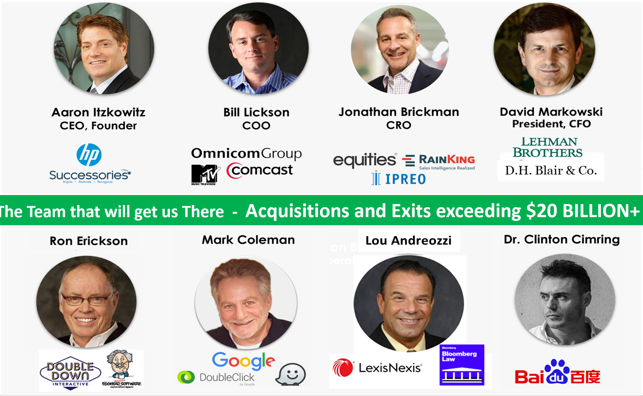
Notes:
The leadership team includes notable directors and advisors.
They have years of C level experience and have been involved in multiple exits exceeding $20 Billion.

Slide 24
Financial Model
Notes:
What does all of this mean for the future of the company and value for the shareholders

Slide 25
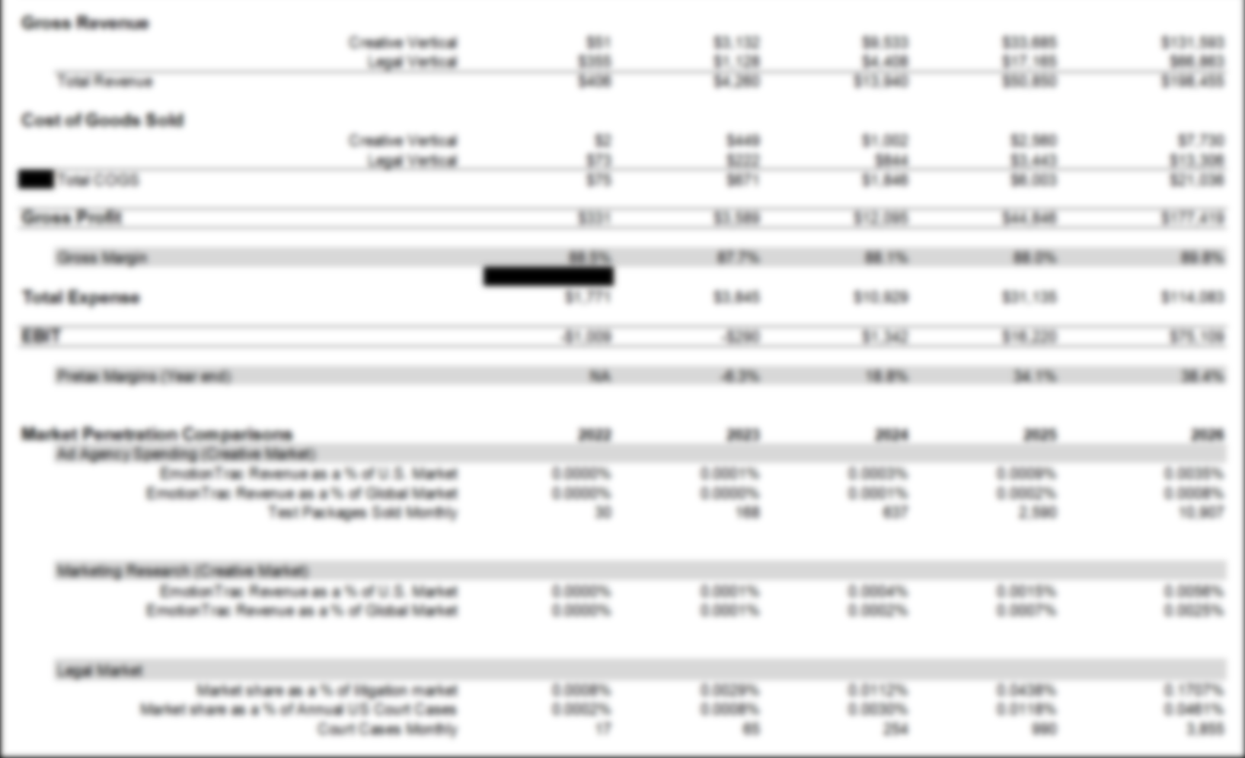
Notes:
We use extensive modeling to support our strategic decisions.
Our EmotionTrac operational modeling shows us that

Slide 26
Fast Scaling Digital Business
90%+ Gross Margins
Notes:
the business can scale quickly due to its digital nature and can achieve 90%+gross margins at critical mass.

Slide 27
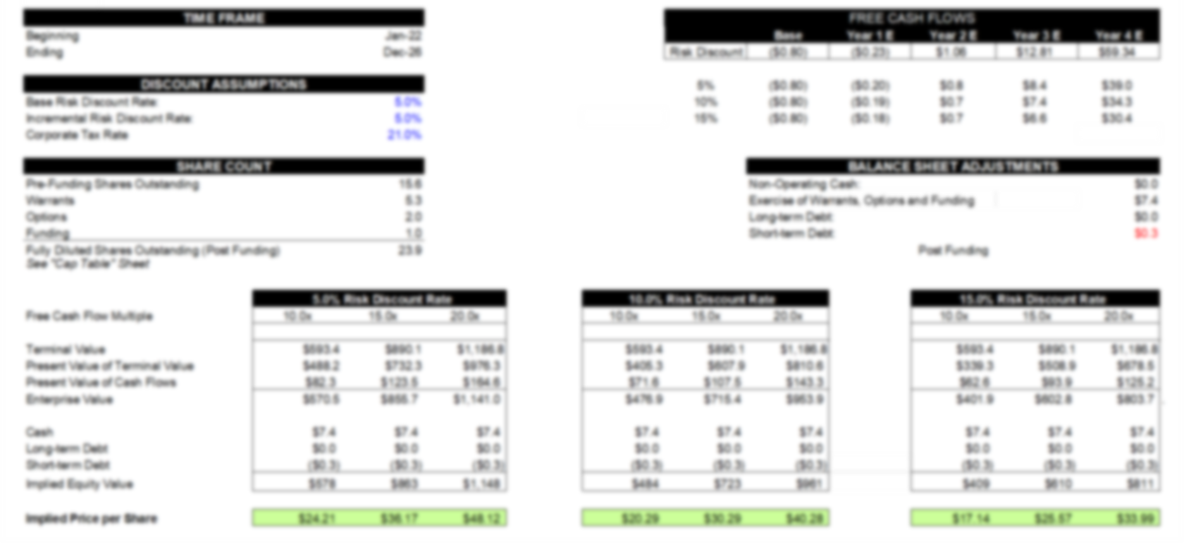
Notes:
Our discounted cash flow valuation shows us that,

Slide 28
Unicorn Status
Valuation = 30 x Revenue
Market Penetration < 0. 01%
Notes:
the projected cashflow from operations at the emotion AI industries 30 times revenue multiple,
is enough to put us into unicorn status,
without ever penetrating more than 1/100th of 1 percent of any market we are targeting.

Slide 29
Contact EmotionTrac
David@EmotionTrac.com
Notes:
If you would like to learn more about the EmotionTrac opportunity please send us note.

